Slide 1

AI for Connect Four
BY: Anthony Ellis, Dalton Atwood, Kenlee Rumer, Raquel Harvey, and Ayden Noyes

Slide 2
History of Connect Four
Originated from the paper and pencil game tic-tac-toe.
Added a few twists to the game including a Three-dimensional board and an extra piece involved to win.
The name "Connect Four" was coined by the Milton Bradley Company in 1974.
The Milton Bradley Company began in Springfield, Massachusetts in 1860

Slide 3
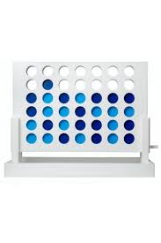
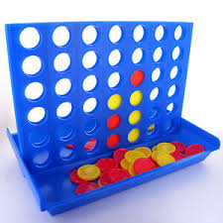
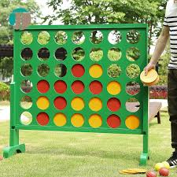
Pictures of the Game

Slide 4
Connect Four Rules
Alternating turns between players.
Place one piece at a time.
Win by becoming the first player to reach 4 pieces in a row.
Winning patterns can be diagonal, horizontal, and vertical.
If all spaces on the board are filled with no winner, the game results in a tie.

Slide 5
Programming Language & Game Engine
Agreed to implement using C#
Use of Unity engine
Allows special effects
Physics
Lighting
Animation

Slide 6
Qualifications & Possible Risks
Qualifications
Familiarity with the use of C# programming language
Knowledge of Artificial Intelligence concepts
Algorithms & Heuristics
Risks
Integration of the Unity Engine may be challenging

Slide 7
Desired Game Features
Start menu
Select desired gamemode
Player vs Player
Player vs AI
Implement AI using the Min-Max algorithm
7 column * 6 row interactive gameboard
Random selection of starting player
Allow players to click the board to drop their piece in the specified column
Animation & sound to simulate falling game pieces
Turn counter and turn tracker
Notify player of a game ending condition (Win, Lose, Tie)
Rematch, Exit, or Return to Menu dialog box

